Slide 1

Analysis of Road Transportation Accidents Using
Data Mining Techniques
Presented by:
Michael Haleem - 40043639
Vivekkumar Chatrola - 40059267
April 12th,2019
Instructor:
Dr. Mazdak Nik-Bakht
Big Data Analytics for Smart City - CIVI 691

Slide 2

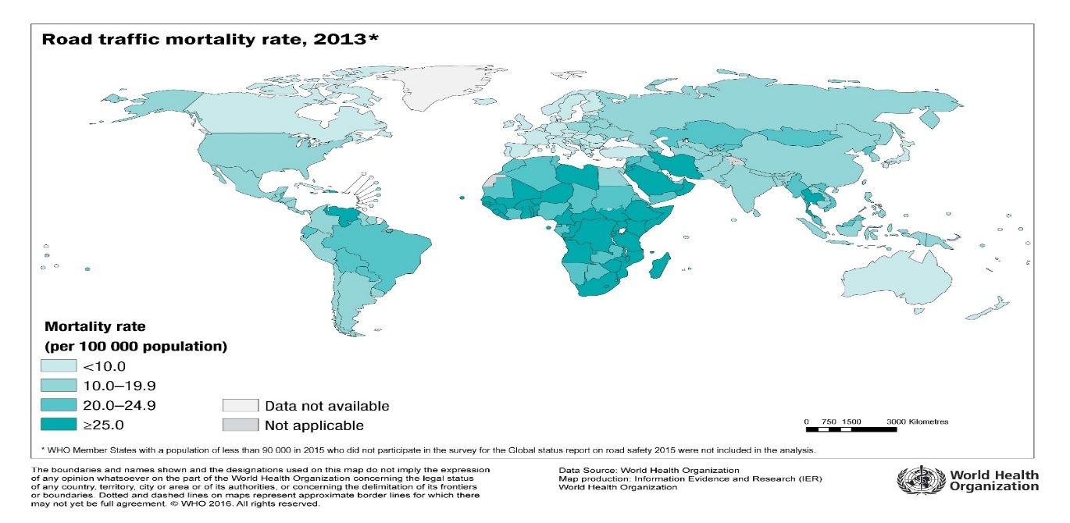
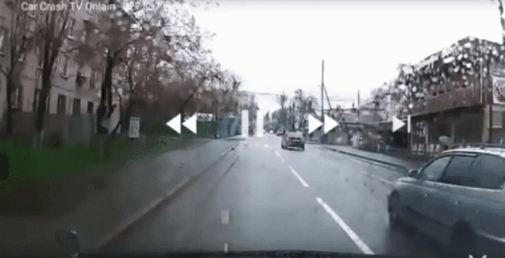
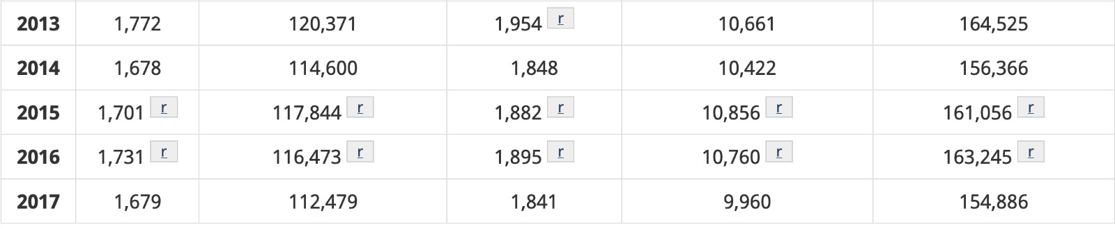
Background
Globally
http://gamapserver.who.int/mapLibrary/app/searchResults.aspx
https://tenor.com/view/car-crash-collision-gif-5894429
Canada
https://www.tc.gc.ca/eng/motorvehiclesafety/canadian-motor-vehicle-traffic-collision-statistics-2017.html
Big Data Analytics for Smart City - CIVI 691

Slide 3
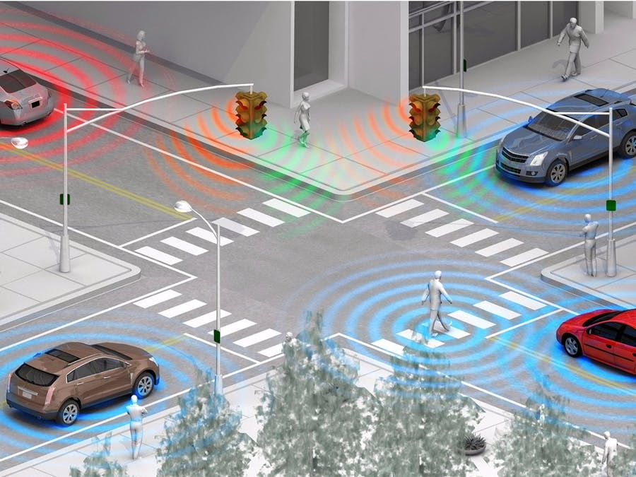
Motivation
Safety
Awareness
Technology
Identification
https://britishleylandautocenter.com/smart-traffic-lights.html
Big Data Analytics for Smart City - CIVI 691

Slide 4

Problem Statement
Reportable Collisions in the city of Ottawa (2013-2017)
Factors causing Accidents
Environ-mental
Lighting
Traffic Control
Road Surface
Year | Collisions
2013 | 15,155
2014 | 14,843
2015 | 15,079
2016 | 14,025
2017 | 14,394
Total | 73,496
(https://ottawa.ca/en/residents/transportation-and-parking/road-safety/annual-safety-reports#2017-ottawa-road-safety-report)
https://www.wayfair.ca/decor-pillows/pdx/ourpostercom-ottawa-city-map-graphic-art-print-poster-in-amuse-orps1417.html
Big Data Analytics for Smart City - CIVI 691

Slide 5

Scope
Objectives
Ottawa's Open Data Portal
Transportation collision data from 2013-17
Environmental and Road Surface Data
No Human behaviour data involved
Finding conditions which lead to different types of collisions
Finding correlation between red-light camera locations and collisions
Finding causes of accidents at most frequent locations
http://www.sclance.com/images/objective/view-page-1.htm
Big Data Analytics for Smart City - CIVI 691

Slide 6


Dataset Introduction
Ottawa's Open Data Catalogue
From 2013 to 2017
73,505 Datapoints & 16 Attributes
Mostly polynomial attributes
Location Attributes
latitude, longitude
Location description
Traffic Attributes
Traffic Control
Red light camera location
Weather Attribute
Environment
Road surface condition
Collision Attributes
Classification of collision
Collision location
Other Attributes
Initial Impact Type
Light
Other Attributes
No. of Pedestrians
Date & Time
Big Data Analytics for Smart City - CIVI 691

Slide 7
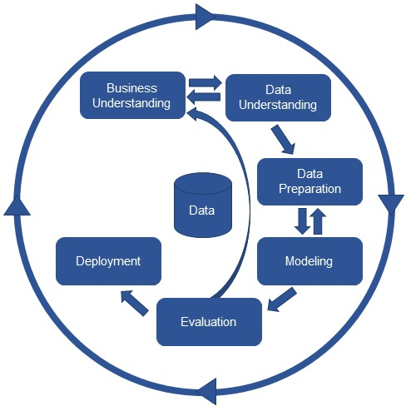

Methodology
Data Preparation
Cleaned Dataset
73,493 Examples
17Attributes
Removed unnecessary attributes and inconsistency
Replaced missing values
Discretized Time and Date
Added Red light Camera attribute
CRISP-DM Approach
https://www.invensis.net/blog/data-processing/5-advantages-of-data-cleansing/
https://www.kdnuggets.com/2017/01/four-problems-crisp-dm-fix.html
Big Data Analytics for Smart City - CIVI 691

Slide 8
Methodology
Data Preparation
General Statistics
Clustering of Accidents locations
K-means clustering
Select the best k based on DBI
Classification model for accident types
Decision Tree Classification
Information Gain Ratio
Number of pedestrians and Accident type as a target variable
Predictive model construction
Extraction of interesting rules
FP-Growth
Accidents type as a conclusion
Rules with strong confidence
Model Evaluation
CRISP-DM Approach
https://www.kdnuggets.com/2017/01/four-problems-crisp-dm-fix.html
10-fold Cross Validation
Big Data Analytics for Smart City - CIVI 691

Slide 9

Question & Answer
Big Data Analytics for Smart City - CIVI 691

